Slide 1
启发式搜索
Lecture 3
HEURISTIC SEARCH
应伟勤

Slide 2
Outline
Heuristics(启发)
Best-First Search(最佳优先搜索)
Implementing Heuristic Evaluation Functions
Measuring Heuristics
  Admissibility
  Monotonicity
  Informedness

Slide 3
自动问题求解器
问题求解器
  将问题表示为状态空间图
  使用无信息的搜索算法(Uninformed Search)寻找从起始状态到目标状态的解路径
  Breadth-First search
  Depth-First search

Slide 4
自动问题求解器
从理论上讲，只要使用上述搜索算法遍历整个状态空间，机器是可以自动找到问题的求解方案的；
但实际上这样的问题求解器只在较简单的问题上才能使用
  实际问题对应的状态空间可能惊人的庞大，这时寻找解路径的穷举搜索的运算开销大到无法承受。
  例如：国际象棋(10¹²⁰ )或旅行商问题中，状态的组合增长是爆炸式的，可能状态的数量随着搜索深度的增大呈指数或阶乘增长。
  搜索这样大的状态空间远远超过了任何计算设备的能力，它的执行过程可能在宇宙崩溃前都无法完成，所以穷举搜索在实践中是不可行的。
Way out: integrate useful information to prune spaces of possible solutions

Slide 5
状态空间的修剪
理想的出路：oracles(神谕，万能的上帝)
  神谕掌握所有的信息和知识，在每一个状态处面临多个分支时，它能够完全准确无误地告知我们应选择哪条分支能够最快到达目标状态
  但是，神谕是不存在的…
现实的出路：heuristics(启发，人类经验和专业知识等)
  人类使用的是带启发的智能搜索：棋手在某种棋局下他仅考虑根据棋谱表明有效的几种走法；医生根据经验分析几种可能的诊断，而不做与患者症状无关的检验。
  Humans do not use exhaustive search. Human problem solving seems to be based on judgmental rules that guide search to those portions of the state space that seem most “promising”.
  These rules are known as heuristics, and they constitute one of the central topics of AI research.

Slide 6
Heuristics(启发)
A heuristic is a strategy for selectively searching a problem space.
In state space search, heuristics are formalized as rules for choosing those branches in a state space that are most likely to lead to an acceptable problem solution.

Slide 7
Heuristics(启发)
Heuristics guide search along lines that have a high probability of success while avoiding wasted or apparently stupid efforts.
By eliminating unpromising states and their descendants from consideration, a heuristic algorithm can defeat the combinatorial explosion and find an acceptable solution.
State space search gives us a means of formalizing the problem-solving process, and heuristics allow us to infuse that formalism with intelligence.

Slide 8
Heuristic Search(启发式搜索)
It is useful to think of heuristic search from two perspectives:
  the heuristic measure and
  an algorithm that uses heuristics to search the state space.

Slide 9
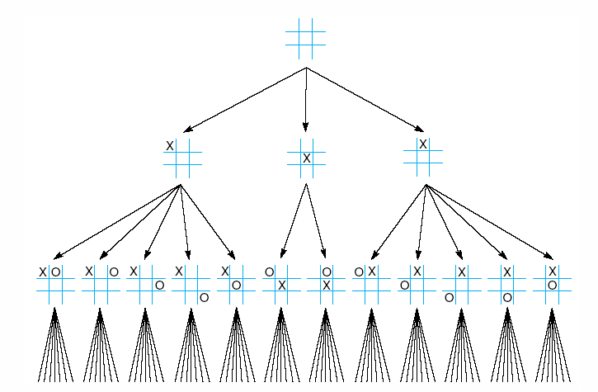
例子：heuristics in the game of tic-tac-toe(九宫游戏)
起始状态是空的棋盘；
两个棋手对弈，轮流下子；
目标状态是三个棋子在一行、一列或对角线的棋盘状态
穷举搜索要考虑的状态数：9！
两层的对称抵消：12*7！
使用启发进一步减小搜索空间

Slide 10
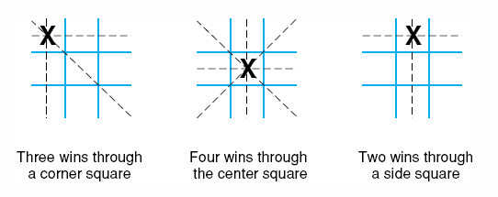
九宫游戏： Heuristics
A simple heuristic: we may move to the state in which X has the most winning opportunities.

Slide 11
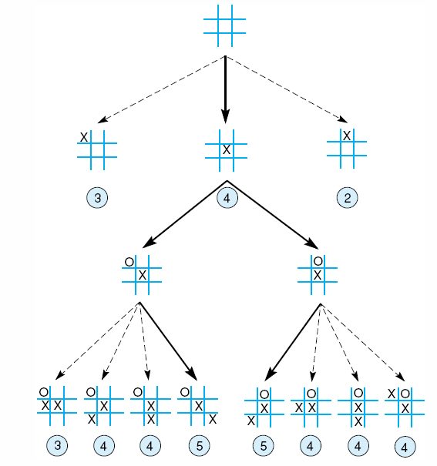
九宫游戏： heuristics
A simple heuristic, however, can almost eliminate search entirely.

Slide 12
启发式搜索heuristic search
使用启发式搜索需要：
  设计好的启发式评价函数
    Heuristic evaluation functions are sufficiently informative to avoid local maxima
  一种灵活的（可使用启发的）搜索算法：最佳优先搜索（best-first search）
    最佳优先搜索使用了一个优先级队列(Open)，启发值最好的结点先从队列取出进行分析
    Open记录已经产生但是等待被分析的状态。
    Closed记录了已经分析过的状态。
    An added step in the algorithm orders the states on open according to some heuristic estimate of their “closeness” to a goal. Thus, each iteration of the loop considers the most “promising” state on the open list.

Slide 13
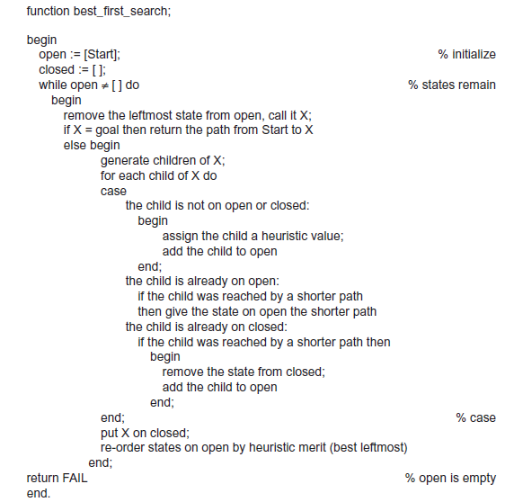
启发式搜索算法：
最佳优先搜索 best-first search
Open记录已经产生但是等待被分析的状态。启发值最优的先出
Closed记录了已经分析过的的状态。

Slide 14
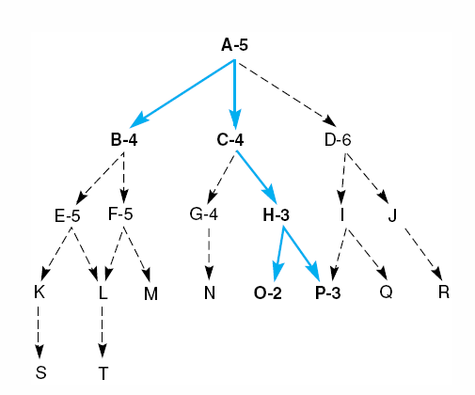
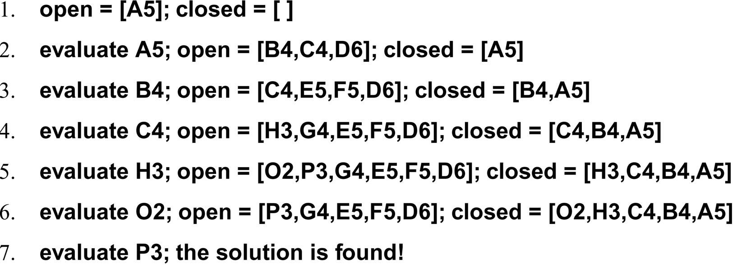
最佳优先搜索例子

Slide 15
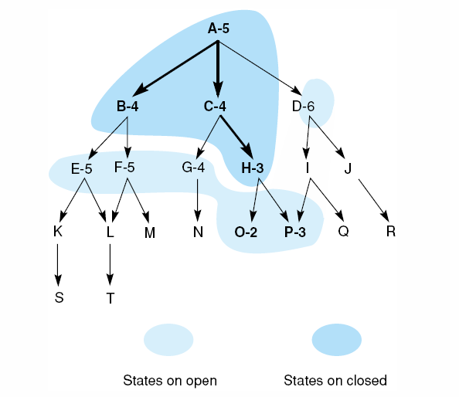
第3次进入迭代前的open列表与closed列表
在发现状态B的孩子的启发值很差时 ，
搜索的焦点转移到状态C
第5次进入迭代前的open列表与closed列表

Slide 16
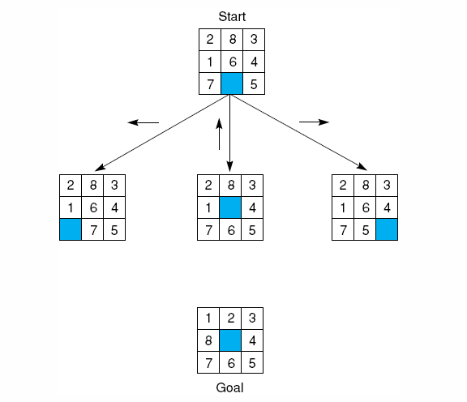
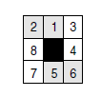
Implementing Heuristic Evaluation Functions
错位牌数
the tiles out of place
八格拼图问题
heuristic estimate function
启发评价函数中的启发估计函数
错位的距离和
Sum of distances
out of place
？
2*直接颠倒数
2 x the number of
direct tile reversals

Slide 17
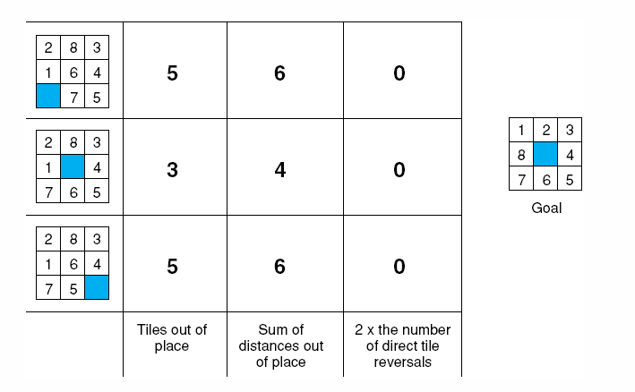
启发估计函数heuristic estimate function
错位牌数
错位的距离和
2*直接颠倒数
距离和+ 2*直接颠倒数

Slide 18
启发式评价函数中的深度度量
(heuristic evaluation function- depth measure )
If two states have the same or nearly the same heuristic estimates, it is generally preferable to examine the state that is nearest to the root state of the graph.
  This state will have a greater probability of being on the shortest path to the goal
The distance from the starting state to its descendants can be measured by maintaining a depth count for each state. This count is 0 for the beginning state and is incremented by 1 for each level of the search.
This depth measure can be added to the heuristic evaluation of each state to bias search in favor of states found shallower in the graph.

Slide 19
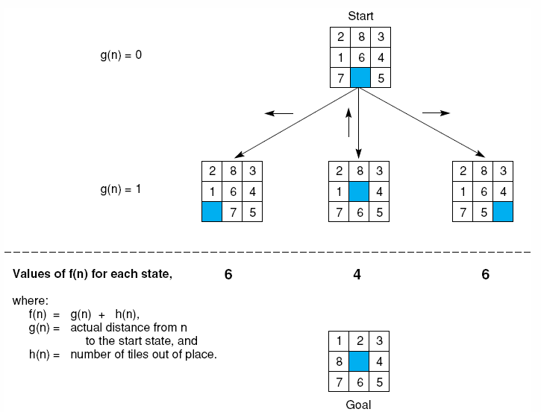
八格拼图问题的启发式评价函数
(heuristic evaluation function)
f(n ) = g(n) + h(n)
g(n): measures the actual length of the path from any state n to the start state
（实际目前已经付出的代价）
h(n): is a heuristic estimate of the distance from state n to a goal
（估计将来还要付出的代价）
启发式评价函数
heuristic evaluation function
深度度量函数
depth measure function
启发估计函数
heuristic estimate function

Slide 21
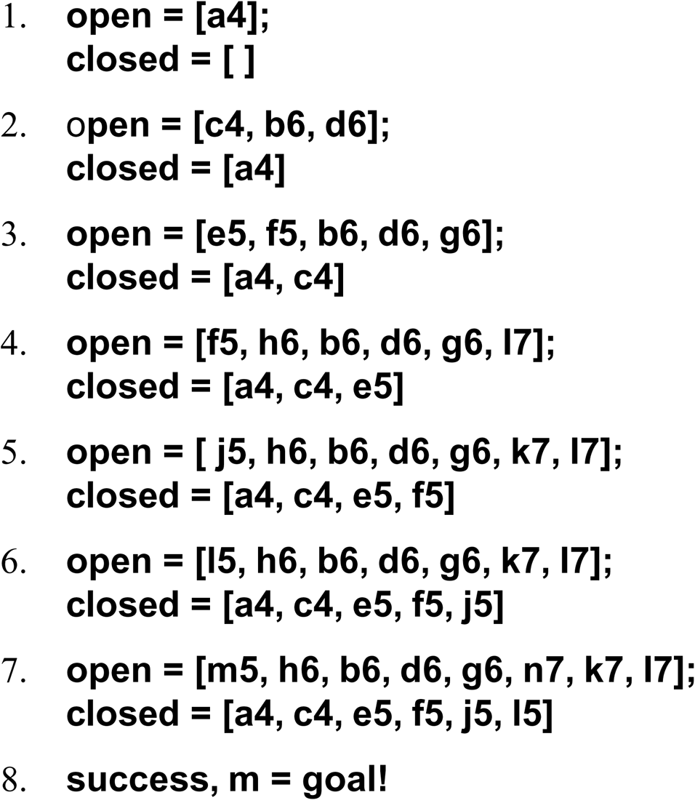
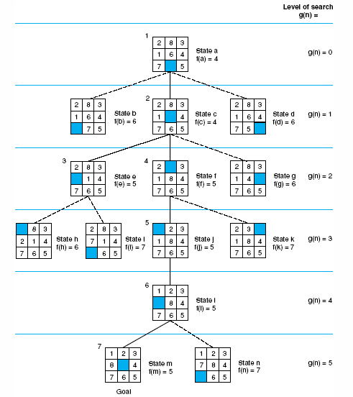

Slide 22
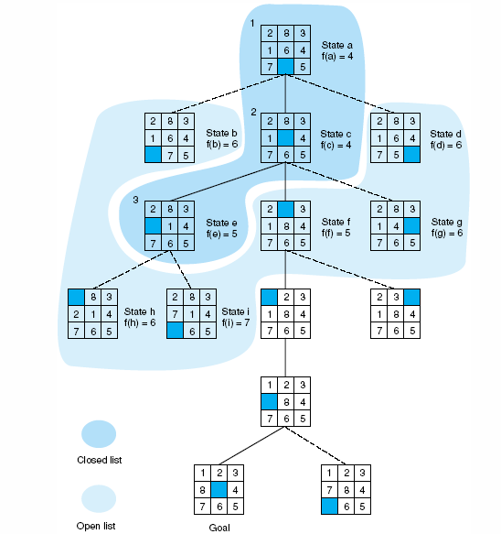

第三次迭代后的列表情况

Slide 23
最佳优先搜索算法总结
分析当前状态时产生新的孩子结点
检查每个新的状态，看其是否已经（在open或close中）出现过，以防止循环、更新到达的更短路径
计算每个孩子状态n的启发评价值f(n)
= 状态在搜索中的深度值g(n)
+状态与目标距离的启发估计值h(n)
  h(n)值把搜索焦点引向更有希望的分支（状态）
  g(n)值防止搜索沿着无用的路径无限跑下去
Open表是根据f(n)排序。

Slide 24
启发的评价指标- Measuring Heuristics
Admissibility(可采纳性)
  we may desire a solution and also require the algorithm to find the shortest path to the goal. This could be important (such as planning a path for an autonomous robot through a dangerous environment). Heuristics that find the shortest path to a goal whenever it exists are said to be admissible.
Monotonicity(单调性)
  When a state is discovered by using heuristic search, is there any guarantee that the same state won’t be found later in the search at a cheaper cost (with a shorter path from the start state)? This is the property of monotonicity.
Informedness (信息度)
  In what sense is one heuristic “better” than another? This is the informedness of a heuristic.

Slide 25
Admissibility Measures (可采纳性指标-定性)
A search algorithm is admissible if it is guaranteed to find a minimal path to a goal whenever such a path exists.
Breadth-first search is an admissible search strategy.
  Because it looks at every state at level n of the graph before considering any state at the level n + 1, any goal nodes are found along the shortest possible path.
  Unfortunately, breadth-first search is often too inefficient for practical use.

Slide 26
Admissbility Measures (可采纳性指标-定量)
Using the evaluation function f(n)=g(n)+h(n), we may characterize a class of admissible heuristic search strategies.
  n is a node in the state space graph
  g(n) measures the depth at which that state has been found in the graph
  h(n) is the heuristic estimate of the distance from n to a goal.
  f(n) estimates the total cost of the path from the start state through n to the goal state.
初始节点
…
…
节点n
g(n)
h(n)
目标节点

Slide 27
Admissbility Measures (可采纳性指标)
In determining the properties of admissible heuristics, we define an ideal evaluation function f*: f*(n)=g*(n)+h*(n)
  g*(n) is the cost of the shortest path from the start to node n
  h*(n) returns the actual cost of the shortest path from n to the goal
  f*(n) is the actual cost of the optimal path from a start node to a goal node that passes through node n
初始节点
…
…
节点n
g(n)
h(n)
目标节点

Slide 28
Admissbility Measures (可采纳性指标)
When we employ best-first search with the ideal evaluation function f*, the resulting search strategy is admissible.
Although oracles (神谕) such as f* do not exist for most real problems, we would like the evaluation function f to be a close estimate of f*.
  g(n), the cost of the current path to state n, is a reasonable estimate of g*, but they may not be equal: g(n) ≥ g*(n). These are equal only if the graph search has discovered the optimal path to state n.
  we replace h*(n) with h(n), a heuristic estimate of the minimal cost to a goal state
  Although we usually may not compute h*, it is often possible to determine whether or not the heuristic estimate, h(n) ≤ h*(n)?, the actual cost of a minimal path.
  If best-first search algorithm uses an evaluation function f in which h(n) ≤ h*(n), it is called algorithm A*.

Slide 29
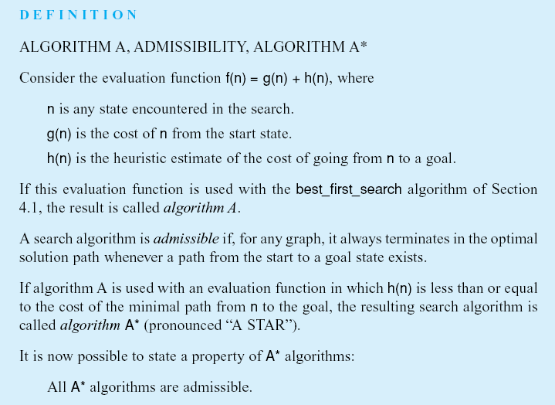
A算法，可采纳性，A*算法
h(n)≤h*(n)

Slide 30
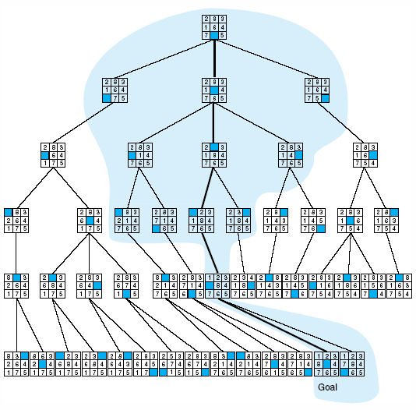
Admissbility Measures (可采纳性指标)
The theorem says that any A* algorithm, i.e., one that uses a heuristic h(n) such that h(n) ≤ h*(n) for all n, is guaranteed to find the minimal path from n to the goal, if such a path exists.
breadth-first search may be characterized as an A* algorithm in which f(n) =g(n) + 0. The decision for considering a state is based solely on its distance from the start state.
  the set of nodes considered by an A* algorithm is a subset of the states examined in breadth-first search.

Slide 31
可采纳性
8格拼图游戏中的几种启发都是可用于A*算法的例子（可采纳的）
  错位牌数
  错位的距离和
  2*直接颠倒数
2
8
3
1
2
3
1
6
4
8
4
7
5
7
6
5
（目标状态）

Slide 32
Monotonicity(单调性指标)
admissible heuristics
  can eventually find an optimal path to a goal
  may initially reach non-goal states along a suboptimal path
If there are heuristics that are “locally admissible,” i.e., that consistently find the minimal path to each state they encounter in the search? This property is called monotonicity.

Slide 33
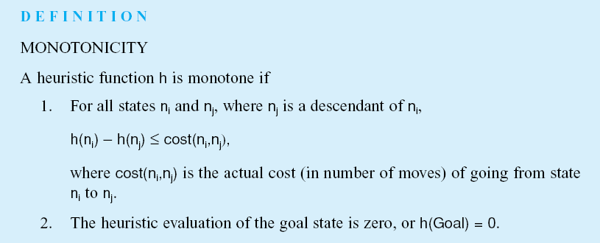
Monotonicity(单调性指标)
Any monotonic heuristic is admissible.(任何单调启发都是可采纳的)

Slide 34
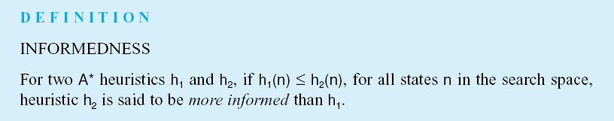
Informedness(信息度)
How to compare two heuristics’ ability to find the minimal path?

Slide 35
Informedness(信息度)
In the case of 8-puzzle, the “number of tiles out of place” heuristic is more informed than breadth-first search.
  breadth-first search is equivalent to the A* algorithm with heuristic h1 such that h1(n) = 0 for all states n. This is, trivially, less than h*.
  The number of tiles out of place with respect to the goal state, h2, is a lower bound for h*.
  h1 ≤ h2 ≤ h*
  Both h1 and h2 find the optimal path, but h2 evaluates many fewer states in the process.
If a heuristic h2 is more informed than h1, then the set of states examined by h2 is a subset of those expanded by h1

Slide 36
启发式搜索与宽度优先搜索状态空间的对比
宽度搜索的h1(n)=0
启发式搜索的h2(n)为错位将牌的数量
信息度越高，搜索空间小
但是高信息度启发所需计算量可能很大，例如下棋
必须在启发的信息度和计算成本之间选择较好的平衡点

